Slide 1
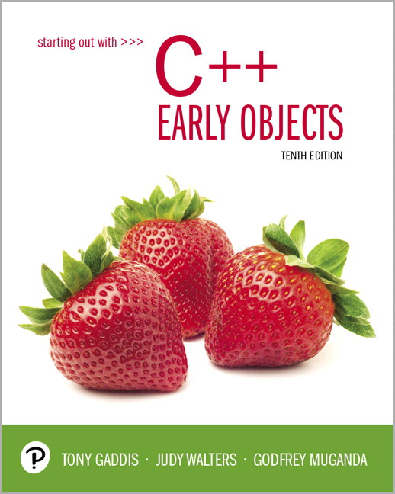
Starting Out with C++ Early Objects
Tenth Edition
Chapter 5
Looping

Slide 2
Topics 1 of 2
5.1 Introduction to Loops: The while Loop
5.2 Using the while loop for Input Validation
5.3 The Increment and Decrement Operators
5.4 Counters
5.5 Keeping a Running Total
5.6 Sentinels

Slide 3
Topics 2 of 2
5.7 The do-while loop
5.8 The for loop
5.9 Deciding Which Loop to Use
5.10 Nested Loops
5.11 Breaking Out of a Loop
5.12 Using Files for Data Storage
5.13 Creating Good Test Data

Slide 4
5.1 Introduction to Loops: The while Loop
Loop: a part of a program that may execute > 1 time (i.e., it repeats)
while loop format:
while (condition)
{ statement(s);
}
The {} can be omitted if there is only one statement in the body of the loop

Slide 5
How the while Loop Works
while (condition)
{ statement(s);
}
condition is evaluated
if it is true, the statement(s) are executed, and then condition is evaluated again
if it is false, the loop is exited
An iteration is an execution of the loop body

Slide 6
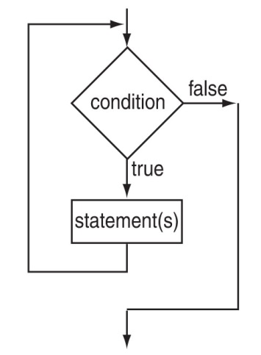
while Loop Flow of Control

Slide 7
while Loop Example
int val = 5;
while (val >= 0)
{ cout << val << " ";
val = val - 1;
}
produces output:
5 4 3 2 1 0
val is called a loop control variable
Notes:
See pr5-01.cpp

Slide 8
while Loop Is a Pretest Loop
while is a pretest loop (the condition is evaluated before the loop executes)
If the condition is initially false, the statement(s) in the body of the loop are never executed
If the condition is initially true, the statement(s) in the body will continue to be executed until the condition becomes false

Slide 9
Exiting the Loop
The loop must contain code to allow the condition to eventually become false so the loop can be exited
Otherwise, you have an infinite loop (i.e., a loop that does not stop)
Example infinite loop:
x = 5;
while (x > 0) // infinite loop because
cout << x; // x is always > 0

Slide 10
Common Loop Errors
Don’t put ; immediately after (condition)
Don’t forget the { } :
int numEntries = 1;
while (numEntries <=3)
cout << "Still working … ";
numEntries++; // not in the loop body
Don’t use = when you mean to use ==
while (numEntries = 3) // always true
{
cout << "Still working … ";
numEntries++;
}

Slide 11
while Loop Programming Style
Loop body statements should be indented
Align { and } with the loop header and place them on lines by themselves
Note: The conventions above make the source code more understandable by someone who is reading it. They have no effect on how the source code compiles or how the program executes.
Notes:
See pr5-02.cpp

Slide 12
5.2 Using the while Loop for Input Validation
Loops are an appropriate structure for
validating user input data
Prompt for and read in the data.
Use a while loop to test if data is valid.
Enter the loop only if data is not valid.
In the loop body, display an error message and prompt the user to re-enter the data.
The loop will not be exited until the user enters valid data.
Notes:
See pr5-03.cpp

Slide 13
Input Validation Loop Example
cout << "Enter a number (1-100) and"
<< " I will guess it. ";
cin >> number;
while ((number < 1) || (number > 100))
{ cout << "Number must be between 1 and 100."
<< " Re-enter your number. ";
cin >> number;
}
// Code to use the valid number follows

Slide 14
5.3 The Increment and Decrement Operators
Increment – increase the value in variable
++ adds one to a variable
val++; is the same as val = val + 1;
Decrement – reduce the value in variable
-- subtracts one from a variable
val--; is the same as val = val – 1;
can be used in prefix mode (before) or
postfix mode (after) a variable
Notes:
See pr5-04.cpp

Slide 15
Prefix Mode
++val and --val increment or decrement the variable, then return the new value of the variable.
It is this returned new value of the variable that is used in any other operations within the same statement

Slide 16
Prefix Mode Example
int x = 1, y = 1;
x = ++y; // y is incremented to 2,
// then 2 is assigned to x
cout << x
<< " " << y; // Displays 2 2
x = --y; // y is decremented to 1,
// then 1 is assigned to x
cout << x
<< " " << y; // Displays 1 1

Slide 17
Postfix Mode
val++ and val-- return the current value of the variable, then increment or decrement the variable
It is this returned current value of the variable that is used in any other operations within the same statement

Slide 18
Postfix Mode Example
int x = 1, y = 1;
x = y++; // y++ returns a 1
// The 1 is assigned to x
// and y is incremented to 2
cout << x
<< " " << y; // Displays 1 2
x = y--; // y-- returns a 2
// The 2 is assigned to x
// and y is decremented to 1
cout << x
<< " " << y; // Displays 2 1
Notes:
See pr5-05.cpp

Slide 19
Increment & Decrement Notes
They can be used in arithmetic expressions
result = num1++ + --num2;
They must be applied to a variable, not an expression or a literal value. You cannot have
result = (num1 + num2)++; // Illegal
They can be used in relational expressions
if (++num > limit)
Pre- and post-operations will cause different comparisons

Slide 20
5.4 Counters
Counter: a variable that is incremented or decremented each time a loop iterates
It can be used to control the execution of the loop (as a loop control variable)
It must be initialized before entering loop
It may be incremented/decremented either inside the loop or in the loop test
Notes:
See pr5-06.cpp

Slide 21
Letting the User Control the Loop
A program can be written so that user input determines loop repetition
This can be used when program processes a list of items, and the user knows the number of items
The user is prompted before the loop is entered. The user input is used to control number of repetitions

Slide 22
User Controls the Loop Example
int num, limit;
cout << "Table of squares\n";
cout << "How high to go? ";
cin >> limit;
cout << "\n\nnumber square\n";
num = 1;
while (num <= limit)
{ cout << setw(5) << num << setw(6)
<< num*num << endl;
num++;
}
Notes:
See pr5-07.cpp

Slide 23
5.5 Keeping a Running Total
running total: an accumulated sum of numbers from iterations of loop
accumulator: a variable that holds running total
int sum = 0, num = 1; // sum is the
while (num <= 10) // accumulator
{ sum += num;
num++;
}
cout << "Sum of numbers 1 – 10 is "
<< sum << endl;
Notes:
See pr5-08.cpp

Slide 24
5.6 Sentinels
sentinel: a value in a list of values that indicates the end of the list
It is a special value that cannot be confused with a valid value, e.g., -999 for a test score
It is used to terminate input when user may not know how many values will be entered

Slide 25
Sentinel Example
int total = 0;
cout << "Enter points earned "
<< "(or -1 to finish): ";
cin >> points;
while (points != -1) // -1 is the sentinel
{
total += points;
cout << "Enter points earned: ";
cin >> points;
}
Notes:
See pr5-09.cpp

Slide 26
5.7 The do-while Loop
do-while: a post test loop (condition is evaluated after the loop executes)
Format:
do
{ 1 or more statements;
} while (condition);
Note the required ;

Slide 27
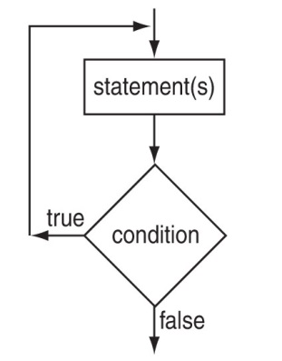
do-while Flow of Control

Slide 28
do-while Loop Notes
The loop body always executes at least once
Execution continues as long as the condition is true; the loop is exited when the condition becomes false
{ } are not required if the body contains a single statement
; after (condition) is required
Notes:
See pr5-10.cpp

Slide 29
do-while and Menu-Driven Programs
do-while can be used in a menu-driven program to bring the user back to the menu to make another choice
To simplify the processing of user input, use the toupper (‘to uppercase’) or tolower (‘to lowercase’) function. This allows you to check user input regardless of the case of the input. Note: requires cctype to be included.

Slide 30
Menu-Driven Program Example
do {
// code to display menu
// and perform actions
cout << "Another choice? (Y/N) ";
} while ((choice =='Y')||(choice=='y'));
The condition could be written as
(toupper(choice) == 'Y');
or as
(tolower(choice) == 'y');
Notes:
See pr5-11.cpp

Slide 31
5.8 The for Loop
It is a pretest loop that executes zero or more times
It is useful for a counter-controlled loop
Format:
for( initialization; test; update )
{ 1 or more statements;
}
Required ;
They don’t go here

Slide 32
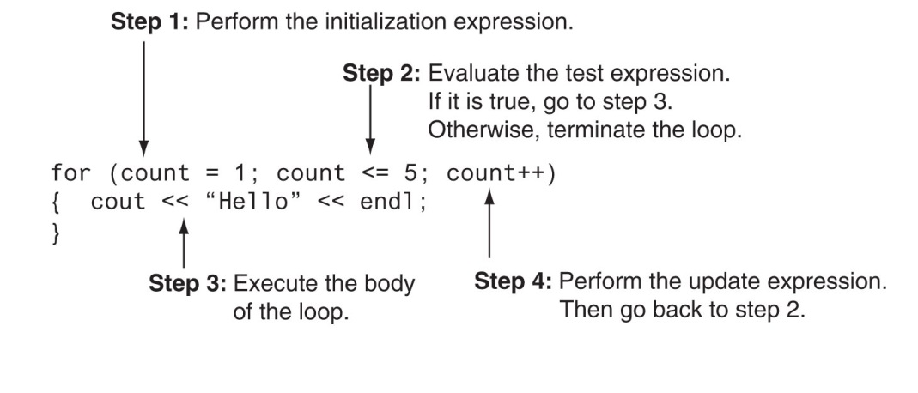
for Loop Mechanics

Slide 33
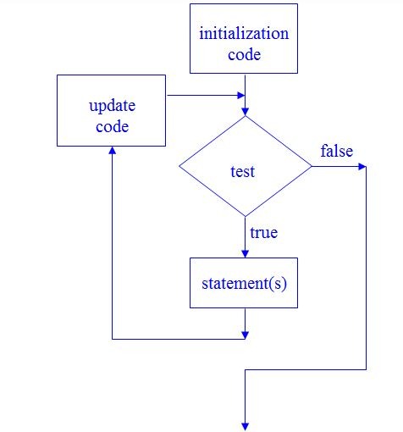
for Loop Flow of Control

Slide 34
for Loop Example
int sum = 0, num;
for (num = 1; num <= 10; num++)
sum += num;
cout << "Sum of numbers 1 – 10 is "
<< sum << endl;
Notes:
See pr5-12.cpp

Slide 35
for Loop Notes
If test is false the first time it is evaluated, the body of the loop will not be executed
The update expression can increment or decrement by any amount
Variables used in the initialization section should not be modified in the body of the loop

Slide 36
for Loop Modifications
You can define variables in initialization code
Their scope is the for loop
Initialization and update code can contain more than one statement
Separate the statements with commas
Example:
for (int sum = 0, num = 1; num <= 10; num++)
sum += num;

Slide 37
More for Loop Modifications (These are NOT Recommended)
Can omit initialization if already done
int sum = 0, num = 1;
for (; num <= 10; num++)
sum += num;
Can omit update if done in loop body
for (sum = 0, num = 1; num <= 10;)
sum += num++;
Can omit the loop body if all of the work is done in the header

Slide 38
5.9 Deciding Which Loop to Use
while: pretest loop (loop body may not be executed at all)
do-while: post test loop (loop body will always be executed at least once)
for: pretest loop (loop body may not be executed at all); has initialization and update code; is useful with counters or if precise number of iterations is known

Slide 39
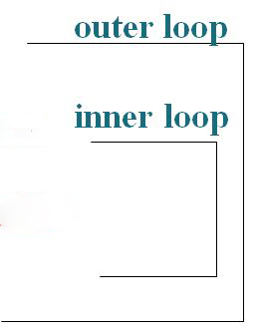
5.10 Nested Loops
A nested loop is a loop that is inside the body of another loop
Example:
for (row = 1; row <= 3; row++)
{
for (col = 1; col <= 3; col++)
{
cout << row * col << endl;
}
}
Notes:
See pr5-13.cpp

Slide 40
Notes on Nested Loops
The inner loop goes through all of its iterations for each iteration of the outer loop
The inner loop completes its iterations faster than the outer loop
The total number of iterations for inner loop is product of number of iterations of the two loops. In previous example, inner loop iterates 9 times in total.

Slide 41
5.11 Breaking Out of a Loop
break can be used to terminate the execution of a loop iteration
Use it sparingly if at all – it makes code harder to understand
When used in an inner loop, break terminates that loop only and returns to the outer loop
Notes:
See pr5-14.cpp

Slide 42
The continue Statement
You can use continue to go to the end of the loop and prepare for next iteration
while and do-while loops go to the test expression and repeat the loop if test is true
for loop goes to the update step, then test, and repeats the loop if test condition is true
Use continue sparingly – like break, it can make program logic hard to understand

Slide 43
5.12 Using Files for Data Storage
We can use a file instead of the computer screen for program output
Files are stored on secondary storage media, such as a disk
Files allow data to be retained between program executions
We can later use the file instead of a keyboard for program input

Slide 44
File Types
Text file – contains information encoded as text, such as letters, digits, and punctuation. It can be viewed with a text editor such as Notepad.
Binary file – contains binary (0s and 1s) information that has not been encoded as text. It cannot be viewed with a text editor.

Slide 45
File Access – Ways to Use the Data in a File
Sequential access – read the 1st piece of data, read the 2nd piece of data, …, read the last piece of data. To access the n-th piece of data, you have to retrieve the preceding (n-1) pieces first.
Random (direct) access – retrieve any piece of data directly, without the need to retrieve preceding data items.

Slide 46
What is Needed to Use Files
Include the ifstream and / or ofstream header file(s)
Define a file stream object
ifstream for input (read data) from a file
ifstream inFile;
ofstream for output (write data) to a file
ofstream outFile;

Slide 47
Open the File 1 of 2
Open the file
Use the open member function
inFile.open("inventory.dat");
outFile.open("report.txt");
The filename may include drive, path info.
The filename must include the full name, including extensions.
The output file will be created if necessary; an existing output file will be erased first
Input file must exist for open to work

Slide 48
Open the File 2 of 2
Creating a filestream object and opening a file can be accomplished in a single statement:
ifstream inFile("inventory.dat");
ofstream outFile("report.txt");
Again, input file must exist in order to be opened.
Output file will be created or erased as needed.

Slide 49
Use the File
Use the file
Can use output file object and << to send data to a file
outFile << "Inventory report";
Can use input file object and >> to copy data from the file to variables
inFile >> partNum;
inFile >> qtyInStock >> qtyOnOrder;
Notes:
See See pr5-15.cpp, pr5-16.cpp, and pr5-17.cpp

Slide 50
Close the File
Close the file
Use the close member function
inFile.close();
outFile.close();
Don’t wait for operating system to close files at program end
There may be limit on number of open files
There may be buffered output data waiting to be sent to a file that could be lost

Slide 51
Input File – the Read Position
Read Position – the location of the next piece of data in an input file
It is initially set to the first byte in the file
It advances for each data item that is read. Successive reads will retrieve successive data items.

Slide 52
User-Specified Filenames
A program can prompt the user to enter the names of input and/or output files. This makes the program more versatile.
Filenames can be read into string objects. In C++ prior to C++ 11, the C-string representation of the string object can be passed to the open function:
cout << "Which input file? ";
cin >> inputFileName;
inFile.open(inputFileName.c_str());
In C++ 11, the string object can be passed to the open() function directly.
Notes:
See pr5-18.cpp and pr5-19.cpp

Slide 53
Using the >> Operator to Test for End of File (EOF) on an Input File
The stream extraction operator (>>) returns a true or false value indicating if a read is successful
This can be tested to find the end of file since the read “fails” (the read expression is false) when there is no more data
Example:
while (inFile >> score)
sum += score;
Notes:
See pr5-19.cpp

Slide 54
File Open Errors
An error will occur if an attempt to open a file for input fails:
File does not exist
Filename is misspelled
File exists, but is in a different place
The file stream object is set to true if the open operation succeeded. It can be tested to see if the file can be used:
if (inFile)
{
// process data from file
}
else
cout << "Error on file open\n";
Notes:
See pr5-20.cpp

Slide 55
5.13 Creating Good Test Data
When testing a program, the quality of the test data is more important than the quantity.
Test data should show how different parts of the program execute
Test data should evaluate how program handles:
normal data
data that is at the limits the valid range
invalid data
Notes:
File pr5-21.cpp

Slide 56

Copyright

Slide 57
Starting Out with C++ Early Objects
Tenth Edition
Chapter 6
Functions

Slide 58
Topics 1 of 2
6.1 Modular Programming
6.2 Defining and Calling Functions
6.3 Function Prototypes
6.4 Sending Data into a Function
6.5 Passing Data by Value
6.6 The return Statement
6.7 Returning a Value from a Function
6.8 Returning a Boolean Value

Slide 59
Topics 2 of 2
6.9 Using Functions in a Menu-Driven Program
6.10 Local and Global Variables
6.11 Static Local Variables
6.12 Default Arguments
6.13 Using Reference Variables as Parameters
6.14 Overloading Functions
6.15 The exit() Function
6.16 Stubs and Drivers

Slide 60
6.1 Modular Programming
Modular programming: breaking a program up into smaller, manageable functions or modules. It supports the divide-and-conquer approach to solving a problem.
Function: a collection of statements to perform a specific task
Motivation for modular programming
Simplifies the process of writing programs
Improves the maintainability of programs

Slide 61
6.2 Defining and Calling Functions
Function call: a statement that causes a function to execute
Function definition: the statements that make up a function

Slide 62
Function Definition 1 of 2
A definition includes
name: the name of the function. Function names follow the same rules as variable names
parameter list: the variables that hold the values that are passed to the function when it is called
body: the statements that perform the function’s task
return type: data type of the value the function returns to the part of the program that called it

Slide 63
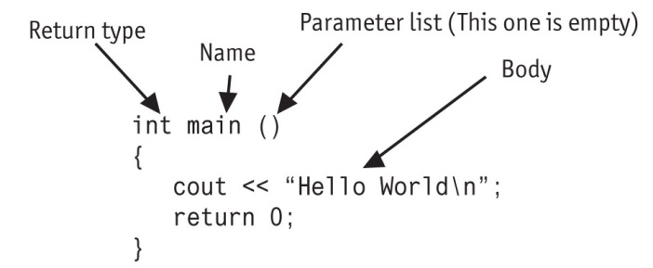
Function Definition 2 of 2

Slide 64
Function Header
The function header consists of
the function return type
the function name
the function parameter list
Example:
int main()
Note: There is no ; at the end of the header

Slide 65
Function Return Type
If a function returns a value, the type of the value must be indicated
int main()
If a function does not return a value, its return type is void
void printHeading()
{
cout << "\tMonthly Sales\n";
}

Slide 66
Calling a Function 1 of 2
To call a function, use the function name followed by () and ;
printHeading();
When a function is called, the program executes the body of the function
After the function terminates, execution resumes in the calling module at the point of call
Notes:
See pr6-01.cpp and pr6-02.cpp

Slide 67
Calling a Function 2 of 2
main is automatically called when the program starts
main can call any number of functions
Functions can call other functions
Notes:
See pr6-03.cpp and pr6-04.cpp

Slide 68
6.3 Function Prototypes 1 of 2
The compiler must know the following about a function before it is called
its name
the return type
the number of parameters
the data type of each parameter

Slide 69
Function Prototypes 2 of 2
There are multiple ways to notify the compiler about a function before making a call to the function:
Place the function definition before the calling function’s definition
Use a function prototype (similar to the header of the function)
Header: void printHeading()
Prototype: void printHeading();
Notes:
See pr6-05.cpp

Slide 70
Prototype Notes
Place prototypes near the top of the program
A program must include either a prototype or full function definition before any call to the function, otherwise a compiler error occurs
When using prototypes, the function definitions can be placed in any order in the source file. Traditionally, main is placed first.

Slide 71
6.4 Sending Data into a Function
You can pass values into a function at time of a call
c = sqrt(a*a + b*b);
Values passed to a function are arguments
Variables in a function that hold values passed as arguments are parameters
Alternate names:
argument: actual argument, actual parameter
parameter: formal argument, formal parameter

Slide 72
Parameters, Prototypes, and Function Headings
For each function argument,
the prototype must include the data type of each parameter in its (). It may also include a parameter name:
void evenOrOdd(int); or
void evenOrOdd(int num); // prototype
the header must include a declaration, with variable type and name, for each parameter in its ()
void evenOrOdd(int num) //header
The call for the above function could look like this: evenOrOdd(val); //call
Notes:
See pr6-06.cpp and pr6-07.cpp

Slide 73
Function Call Notes
The value of the argument is copied into the parameter when the function is called
A function can have > 1 parameter
There must be a data type listed in the prototype () and an argument declaration in the function heading () for each parameter
Arguments will be promoted/demoted as necessary to match parameters. Be careful!
Notes:
See pr6-08.cpp

Slide 74
Calling Functions with Multiple Arguments
When calling a function with multiple arguments
the number of arguments in the call must match the function prototype and definition
the value of the first argument will be copied into the first parameter, the value of the second argument into the second parameter, etc.

Slide 75
Calling Functions with Multiple Arguments Illustration
displayData(height, weight); // call
void displayData(int h, int w)// header
{
cout << "Height = " << h << endl;
cout << "Weight = " << w << endl;
}

Slide 76
6.5 Passing Data by Value
Pass by value: when an argument is passed to a function, a copy of its value is placed in the parameter
The function cannot access the original argument
Changes made to the parameter in the function do not affect the value of the argument in the calling function

Slide 77
Passing Data to Parameters by Value
Example: int val = 5;
evenOrOdd(val);
evenOrOdd may change the variable num, but it will have no effect on variable val
val
num
5
5
argument in
calling function
parameter in
evenOrOdd function
Notes:
See pr6-09.cpp

Slide 78
6.6 The return Statement
Is used to end execution of a function
It can be placed anywhere in a function
Statements that follow the return statement will not be executed
It can be used to prevent abnormal termination of program
Without a return statement, the function ends at its last }
Notes:
See pr6-10.cpp

Slide 79
6.7 Returning a Value from a Function
The return statement can be used to return a value from a function to the module that made the function call
The prototype and function header must indicate the data type of return value (not void)
The calling function should use the returned value, e.g.,
assign it to a variable
send it to cout
use it in an arithmetic computation
use it in a relational expression
Notes:
See pr6-11.cpp and pr6-12.cpp

Slide 80
Returning a Value – the return Statement
Format: return expression;
expression may be a variable, a literal value, or an expression.
expression should be of the same data type as the declared return type of the function (it will be converted if not)

Slide 81
6.8 Returning a Boolean Value
A function can return true or false
You can declare the return type in the function prototype and header as bool
The function body must contain return statement(s) that return true, false, or bool variables or expressions.
The calling function can use the return value in a relational expression

Slide 82
Boolean return Example
bool isValid(int); // prototype
bool isValid(int val) // header
{
int min = 0, max = 100;
if (val >= min && val <= max)
return true;
else
return false;
}
if (isValid(score)) // call
…
Notes:
See pr6-13.cpp

Slide 83
Programming Style and return statements
A function may calculate a return value and use a single return statement. The previous example could be written as:
bool isValid(int val) // header
{
bool result;
int min = 0, max = 100;
if (val >= min && val <= max)
result = true;
else
result = false;
return result; // single return
}
…
Notes:
See pr6-13.cpp

Slide 84
6.9 Using Functions in a Menu-Driven Program
Functions can be used
to implement user choices from menus
to implement general-purpose tasks
Higher-level functions can call general-purpose functions
This minimizes the total number of functions and speeds program development time
Notes:
See pr6-14.cpp

Slide 85
Screen Management in a Menu-Driven Program
You can clear the screen to remove prior output while a program is running:
Windows: system("cls");
Linux and Mac OS: system("clear");
To allow the user enough time to read output before the screen clears, use code like:
cout << "Press the Enter key to continue.";
cin.get(); // clear the input buffer
cin.get(); // get the Enter key
Notes:
See pr6-14.cpp

Slide 86
6.10 Local and Global Variables
local variable: is defined within a function or a block; accessible only within the function or the block. Parameters are also local variables.
Other functions and blocks can define variables with the same name
When a function is called, local variables in the calling function are not accessible from within the called function
Notes:
See pr6-15.cpp

Slide 87
Local Variable Lifetime
A local variable only exists while its defining function is executing
Local variables created when a function defines them and are destroyed when the function terminates
Data cannot be retained in local variables between calls to the function in which they are defined

Slide 88
Local and Global Variables
global variable: a variable defined outside all functions; it is accessible to all functions within its scope
Can be sean as an easy way to share data between functions
Scope of a global variable is from its point of definition to the program end
Use sparingly

Slide 89
Initializing Local and Global Variables
Local variables must be initialized by the programmer
Global variables are initialized to 0 (numeric) or NULL (character) when the variable is defined. These can be overridden with explicit initial values.
Notes:
See pr6-16.cpp and pr6-17.cpp

Slide 90
Global Variables – Why ‘Use Sparingly’?
Global variables make:
Programs that are difficult to debug
Functions that cannot easily be re-used in other programs
Programs that are hard to understand

Slide 91
Global Constants
A global constant is a named constant that can be used by every function in a program
It is useful if there are unchanging values that are used throughout the program
They are safer to use than global variables, since the value of a constant cannot be modified during program execution
Notes:
See pr6-18.cpp

Slide 92
Local and Global Variable Names
Local variables can have same names as global variables
When a function contains a local variable that has the same name as a global variable, the global variable is unavailable from within the function. The local definition "hides" or "shadows" the global definition.
Notes:
See pr6-19.cpp

Slide 93
6.11 Static Local Variables
Local variables
Only exist while the function is executing
Are redefined each time function is called
Lose their contents when function terminates
static local variables
Are defined with key word static
static int counter;
Are defined and initialized only the first time the function is executed
Retain their values between function calls
Notes:
See pr6-20.cpp and pr6-21.cpp

Slide 94
6.12 Default Arguments 1 of 2
Values that are passed automatically if arguments are missing from a function call
Must be a constant or literal declared in the prototype or header (whichever occurs first)
void evenOrOdd(int x = 0);
Multi-parameter functions may have default arguments for some or all parameters
int getSum(int, int=0, int=0);
Notes:
See pr6-22.cpp

Slide 95
Default Arguments 2 of 2
If not all parameters to a function have default values, the ones without defaults must be declared first in the parameter list
int getSum(int, int=0, int=0);// OK
int getSum(int, int=0, int); // wrong!
When an argument is omitted from a function call, all arguments after it must also be omitted
sum = getSum(num1, num2); // OK
sum = getSum(num1, , num3); // wrong!

Slide 96
6.13 Using Reference Variables as Parameters
This is a mechanism that allows a function to work with the original argument from the function call, not a copy of the argument
It allows the function to modify values that are stored in the calling environment
It provides a way for the function to ‘return’ more than 1 value

Slide 97
Reference Variables
A reference variable is an alias for another variable
When used as a function parameter, it is defined with an ampersand (&) in the prototype and in the header
void getDimensions(int&, int&);
Changes made to a reference variable are made to the variable it refers to
Use reference variables to implement passing parameters by reference

Slide 98
Pass by Reference Example
void squareIt(int &); //prototype
void squareIt(int &num)
{
num *= num;
}
int localVar = 5;
squareIt(localVar); // localVar now
// contains 25
Notes:
See pr6-23.cpp and pr6-24.cpp

Slide 99
Reference Variable Notes
Each reference parameter must contain &
An argument passed to a reference parameter must be a variable. It cannot be an expression or a constant.
Use only when it is appropriate, such as when the function must input or change the value of the argument passed to it.
Files (i.e., file stream objects) should be passed by reference.
Notes:
See pr6-25.cpp, pr6-26.cpp, and pr6-27.cpp

Slide 100
6.14 Overloading Functions
The signature of a function is the function name and the data types of the parameters, in order. The return type is not part of the signature.
Overloaded functions are two or more functions that have the same name but different signatures
This can be used to create functions that perform the same task but take different parameter types or a different number of parameters
The compiler will determine which version of the function to call by the argument and parameter lists

Slide 101
Overloaded Functions Example
If a program has these overloaded functions,
void getDimensions(int); // 1
void getDimensions(int, int); // 2
void getDimensions(int, float); // 3
void getDimensions(double, double);// 4
then the compiler will use them as follows:
int length, width;
double base, height;
getDimensions(length); // 1
getDimensions(length, width); // 2
getDimensions(length, height); // 3
getDimensions(height, base); // 4
Notes:
See pr6-28.cpp and pr6-29.cpp

Slide 102
6.15 The exit() Function
Terminates the execution of a program
Can be called from any function
Can be used to pass a value to operating system to indicate the status of program execution
Usually used for abnormal termination of program
Requires cstdlib header file
Use it with caution
Notes:
See pr6-30.cpp

Slide 103
exit() – Passing Values to Operating System
Use an integer value to indicate program status
Often, 0 means successful completion, non-zero indicates a failure condition
Can use named constants defined in cstdlib:
EXIT_SUCCESS and
EXIT_FAILURE

Slide 104
6.16 Stubs and Drivers
Stub: A dummy function used in place of an actual function
It usually displays a message indicating it was called. May also display the values of the arguments and return a test value.
Driver: A function that tests a function by calling it
Stubs and drivers are useful for testing and debugging program logic and design
Notes:
See pr6-31.cpp

Slide 105
Copyright

Slide 106
Starting Out with C++ Early Objects
Tenth Edition
Chapter 7
Introduction to Classes and Objects

Slide 107
Topics 1 of 2
7.1 Abstract Data Types
7.2 Object-Oriented Programming
7.3 Introduction to Classes
7.4 Creating and Using Objects
7.5 Defining Member Functions
7.6 Constructors
7.7 Destructors
7.8 Private Member Functions

Slide 108
Topics 2 of 2
7.9 Passing Objects to Functions
7.10 Object Composition
7.11 Separating Class Specification, Implementation, and Client Code
7.12 Structures
7.13 More About Enumerated Data Types
7.15 Introduction to Object-Oriented Analysis and Design
7.16 Screen Control

Slide 109
7.1 Abstract Data Types
Are programmer-created data types that specify
the legal values that can be stored
the operations that can be done on the values
The user of an abstract data type (ADT) does not need to know any implementation details (e.g., how the data is stored or how the operations on it are carried out)

Slide 110
Abstraction in Software Development
Abstraction allows a programmer to design a solution to a problem and to use data items without concern for how the data items are implemented
This has already been encountered in the book:
To use the pow function, you need to know what inputs it expects and what kind of results it produces
You do not need to know how it works

Slide 111
Abstraction and Data Types
Abstraction: a definition that captures general characteristics without details
ex: An abstract triangle is a 3-sided polygon. A specific triangle may be scalene, isosceles, or equilateral
Data Type: defines the kind of values that can be stored and the operations that can be performed on the values

Slide 112
7.2 Object-Oriented Programming
Procedural programming uses variables to store data, and focuses on the processes/ functions that occur in a program. Data and functions are separate and distinct.
Object-oriented programming is based on objects that encapsulate the data and the functions that operate with and on the data.

Slide 113
Object-Oriented Programming Terminology 1 of 2
object: software entity that combines data and functions that act on the data in a single unit
attributes: the data items of an object, stored in member variables
member functions (methods): procedures/ functions that act on the attributes of the class

Slide 114
Object-Oriented Programming Terminology 2 of 2
data hiding: restricting data access to certain members of an object. The intent is to allow only member functions to directly access and modify the object’s data
encapsulation: the bundling of an object’s data and procedures into a single entity

Slide 115
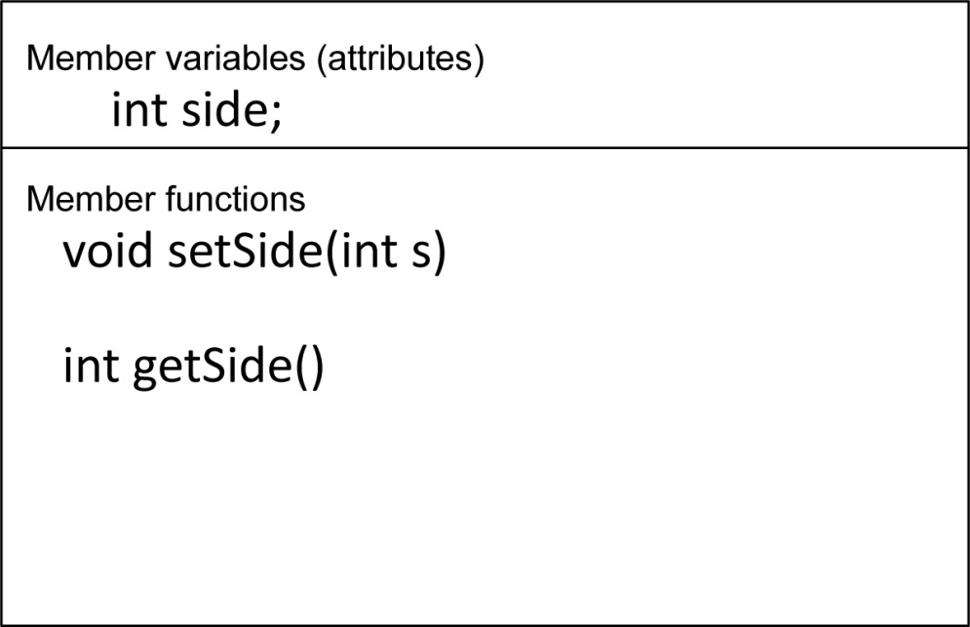
Object Example
Square
Square object’s data item: side
Square object’s functions: setSide - set the size of the side of the square, getSide - return the size of the side of the square

Slide 116
Why Hide Data?
Protection – Member functions provide a layer of protection against inadvertent or deliberate data corruption
Need-to-know – A programmer can use the data via the provided member functions. As long as the member functions return correct information, the programmer needn’t worry about implementation details.

Slide 117
7.3 Introduction to Classes 1 of 2
Class: a programmer-defined data type used to define objects
It is a pattern for creating objects
ex:
string fName, lName;
This creates two objects of the string class

Slide 118
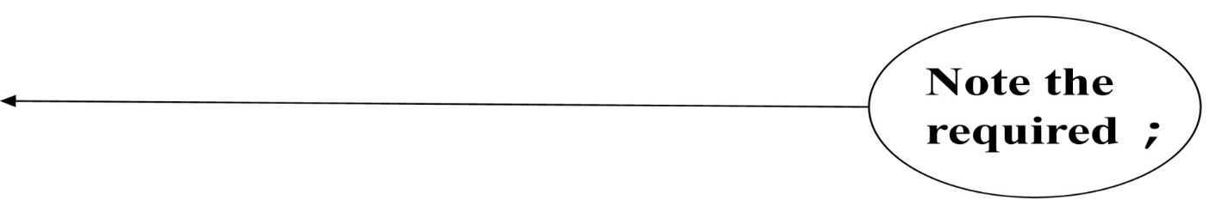
Introduction to Classes 2 of 2
Class declaration format:
class className
{
declaration;
declaration;
};

Slide 119
Access Specifiers
Used to control access to members of the class.
Each member is declared to be either
public: can be accessed by functions
outside of the class
or
private: can only be called by or accessed
by functions that are members of
the class

Slide 120
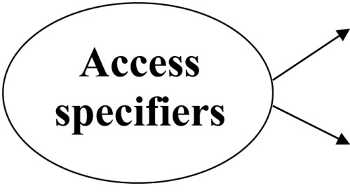
Class Example
class Square
{
private:
int side;
public:
void setSide(int s)
{ side = s; }
int getSide()
{ return side; }
};

Slide 121
More on Access Specifiers
Can be listed in any order in a class
Can appear multiple times in a class
If not specified, the default is private

Slide 122
7.4 Creating and Using Objects
An object is an instance of a class
It is defined just like other variables
Square sq1, sq2;
It can access members using dot operator
sq1.setSide(5);
cout << sq1.getSide();
Notes:
See pr7-01.cpp

Slide 123
Types of Member Functions
Acessor, get, getter function: uses but does not modify a member variable
ex: getSide
Mutator, set, setter function: modifies a member variable
ex: setSide

Slide 124
7.5 Defining Member Functions
Member functions are part of a class declaration
You can place entire function definition inside the class declaration,
or
You can place just the prototype inside the class declaration and write the function definition after the class

Slide 125
Defining Member Functions Inside the Class Declaration
Member functions defined inside the class declaration are called inline functions
Only very short functions, like the one below, should be inline functions
int getSide()
{ return side; }

Slide 126
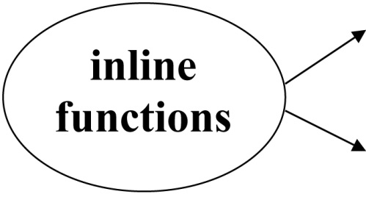
Inline Member Function Example
class Square
{
private:
int side;
public:
void setSide(int s)
{ side = s; }
int getSide()
{ return side; }
};

Slide 127
Defining Member Functions After the Class Declaration
Use a function prototype in the class declaration
In the function definition, precede the function name with the class name and scope resolution operator (::)
int Square::getSide()
{
return side;
}
Notes:
See pr7-02.cpp and pr7-03.cpp

Slide 128
Conventions and a Suggestion
Conventions:
Member variables are usually private
Accessor and mutator functions are usually public
Use ‘get’ in the name of accessor functions, ‘set’ in the name of mutator functions
Suggestion: calculate values to be returned in accessor functions when possible, to minimize the potential for stale data

Slide 129
Tradeoffs of Inline vs. Regular Member Functions
When a regular function is called, control passes to the called function
the compiler stores return address of call, allocates memory for local variables, etc.
Code for an inline function is copied into the program in place of the call when the program is compiled
This makes a larger executable program, but
There is less function call overhead, and possibly faster execution

Slide 130
7.6 Constructors
A constructor is a member function that is automatically called when an object of the class is created
Is can be used to initialize data members
It must be a public member function
It must be named the same as the class
It must have no return type
Notes:
See pr7-04.cpp and pr7-05.cpp

Slide 131
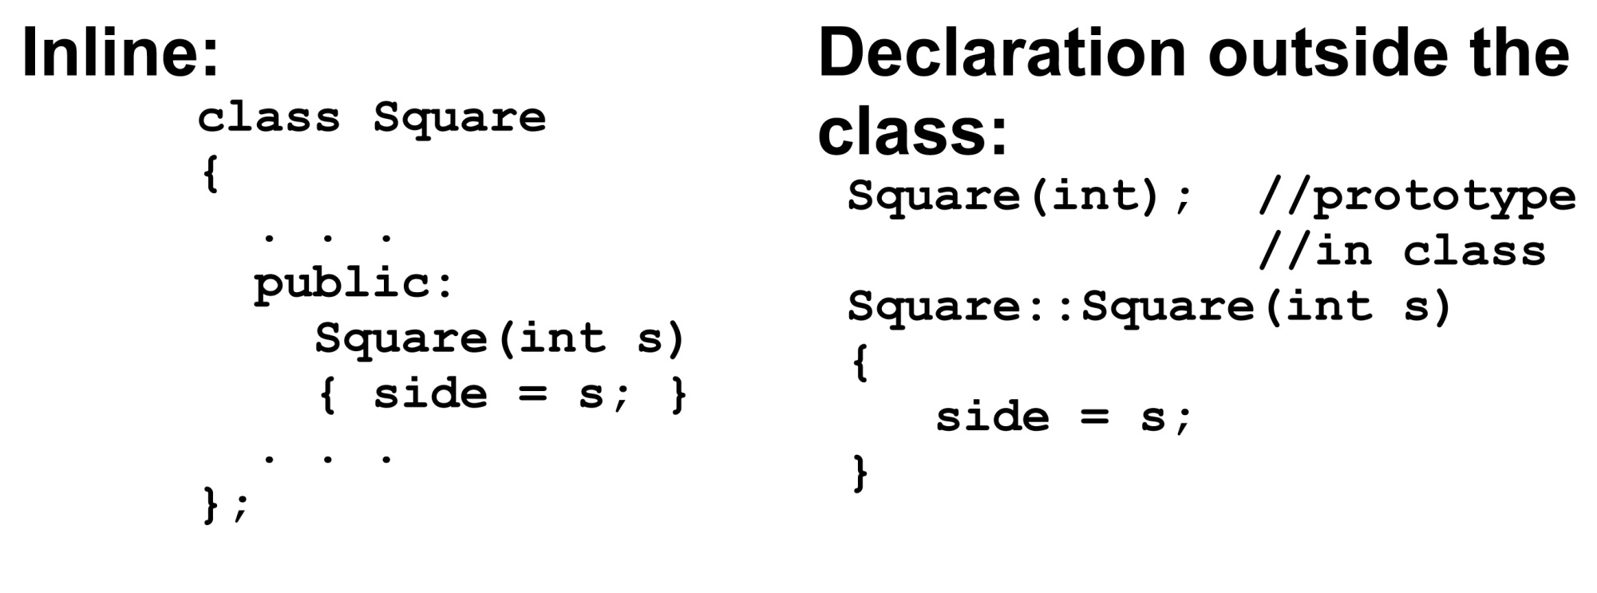
Constructor – 2 Examples

Slide 132
Overloading Constructors
A class can have more than 1 constructor
Overloaded constructors in a class must have different parameter lists
Square();
Square(int);
Notes:
See pr7-06.cpp

Slide 133
The Default Constructor
Constructors can have any number of parameters, including none
A default constructor is one that takes no arguments either due to
No parameters or
All parameters have default values
If a class has any programmer-defined constructors, it should have a programmer - defined default constructor

Slide 134
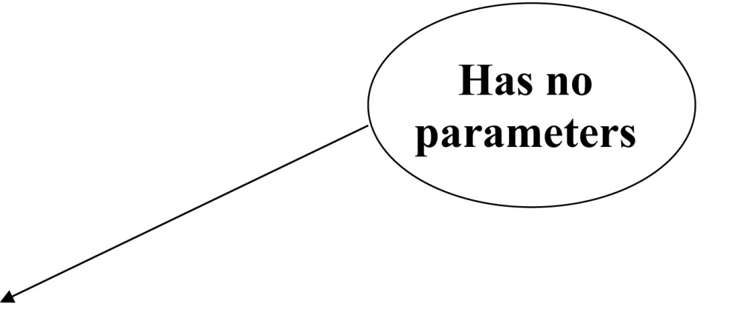
Default Constructor Example
class Square
{
private:
int side;
public:
Square() // default
{ side = 1; } // constructor
// Other member
// functions go here
};

Slide 135
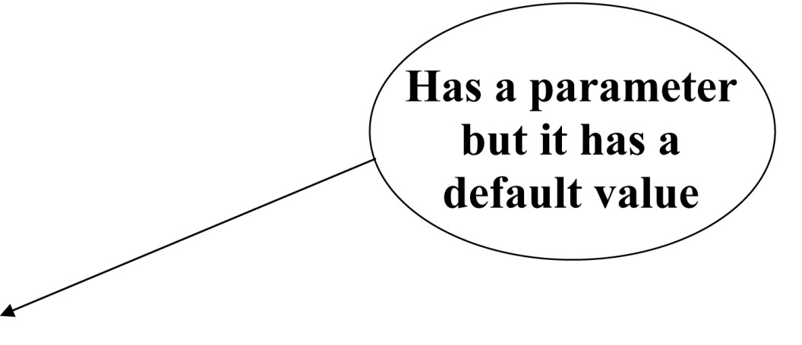
Another Default Constructor Example
class Square
{
private:
int side;
public:
Square(int s = 1) // default
{ side = s; } // constructor
// Other member
// functions go here
};

Slide 136
Invoking a Constructor
To create an object using the default constructor, use no argument list and no ()
Square square1;
To create an object using a constructor that has parameters, include an argument list
Square square2(8);

Slide 137
Member Initialization List 1 of 2
Member variables can be initialized using a member initialization list: a comma-separated list of member variables and initial values following the header of the constructor and before the body.
Examples:
Square() : side(1)
{ }
Square(int size) : side(size)
{ }

Slide 138
Member Initialization List 2 of 2
Notes:
: is required between header and initialization list
no ; at the end of the initialization list
initialization list precedes the function body. It can be on the same or the following line of the header.
The initialization list may accomplish all that is needed in a constructor. In this case, the body of the constructor is empty. The { } are still required.

Slide 139
In-Place Member Initialization List
Starting with C++ 11, member variables can be initialized at the time that they are defined in the class declaration. This provides default values those variables for all objects created from the class.
Default values can be overridden by using a constructor that takes parameters for the variables that have been initialized in-place.

Slide 140
Constructor Delegation
Starting with C++ 11, a constructor in a class can call another constructor in the same class. This is called constructor delegation.
The notation is similar to member initialization list
Example: // default constructor Square(): Square(1)
{ }
Square(int s)
{ side = s; }

Slide 141
Constructor Delegation Notes
The default constructor delegates the work to the constructor that takes one argument.
It calls the non-default constructor and passes the initial value as an argument.
// default constructor Square(): Square(1)
{ }
Square(int s)
{ side = s; }

Slide 142
7.7 Destructors
Is a public member function automatically called when an object is destroyed
The destructor name is ~className, e.g., ~Square
It has no return type
It takes no arguments
Only 1 destructor is allowed per class
(i.e., it cannot be overloaded)
Notes:
See pr7-07.cpp

Slide 143
7. 8 Private Member Functions
A private member function can only be called by another member function of the same class
It is used for internal processing by the class, not for use outside of the class
Notes:
See pr7-08.cpp

Slide 144
7.9 Passing Objects to Functions
A class object can be passed as an argument to a function.
When it is passed by value, the function makes a local copy of the object. The original object in the calling environment is unaffected by actions in the function.
When passed by reference, the function can use ‘set’ functions to modify the object in the calling environment.
Notes:
See pr7-09.cpp

Slide 145
Notes on Passing Objects 1 of 2
Using a value parameter for an object can slow down a program and waste space
Using a reference parameter speeds up the program. However, it allows the function to modify the data in the parameter, which is the same as the argument in the calling part of the program. This may not be desirable.

Slide 146
Notes on Passing Objects 2 of 2
To save space and time while protecting parameter data that should not be changed, use a const reference parameter in the header and the prototype:
void showData(const Square &s)
// header
In order to for the showData function to call Square member functions, those functions must use const in their prototype and header:
int Square::getSide() const;

Slide 147
Returning an Object from a Function
A function can return an object
Square initSquare(); // prototype
Square s1 = initSquare();// call
The function must create an object
for internal use
to use with the return statement

Slide 148
Returning an Object Example
Square initSquare()
{
Square s; // local object
int inputSize;
cout << "Enter the length of side: ";
cin >> inputSize;
s.setSide(inputSize);
return s;
}
Notes:
See pr7-10.cpp

Slide 149
7.10 Object Composition 1 of 2
This occurs when an object is a member variable of another object.
It is often used to design complex objects whose members are simpler objects
ex. (from book): Define a rectangle class. Then, define a carpet class and use a rectangle object as a member of a carpet object.
Notes:
See pr7-11.cpp

Slide 150
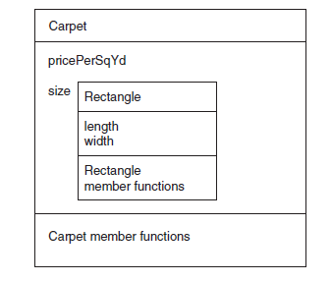
Object Composition 2 of 2

Slide 151
7.11 Separating Class Specification, Implementation, and Client Code
Separating the class declaration, member function definitions, and the program that uses the class into separate files is considered good design.

Slide 152
Using Separate Files
Place class declaration in a header file that serves as the class specification file. Name the file classname.h (for example, Square.h)
Place member function definitions in a class implementation file. Name the file classname.cpp (for example, Square.cpp)This file should #include the class specification file.
A client program (client code) that uses the class must #include the class specification file and be compiled and linked with the class implementation file.
Notes:
See pr7-12.cpp, Rectangle.cpp, and Rectangle.h

Slide 153
Include Guards
Are used to prevent a header file from being included twice
Format: #ifndef symbol_name
#define symbol_name
. . . (normal contents of header file)
#endif
symbol_name is usually the name of the header file, in all capital letters:
#ifndef SQUARE_H
#define SQUARE_H
. . .
#endif

Slide 154
What Should Be Done Inside vs. Outside of the Class
Class should be designed to provide functions to store and retrieve data
In general, input and output (I/O) should be done by functions that use class objects, rather than by class member functions
Notes:
See Rectangle.h, Rectangle.cpp, and pr7-12.cpp

Slide 155
7.12 Structures
Structure: A programmer-defined data type that allows multiple variables to be grouped together
Structure declaration format:
struct structure name
{
type1 field1;
type2 field2;
…
typen fieldn;
};

Slide 156
Example struct Declaration
struct Student // structure name
{
int studentID;// structure
string name; // members
short year;
double gpa;
}; // The ; is required

Slide 157
struct Declaration Notes
struct names commonly begin with an uppercase letter
Multiple fields of same type can be declared in a comma-separated list
string name,
address;
Fields in a structure are all public by default

Slide 158
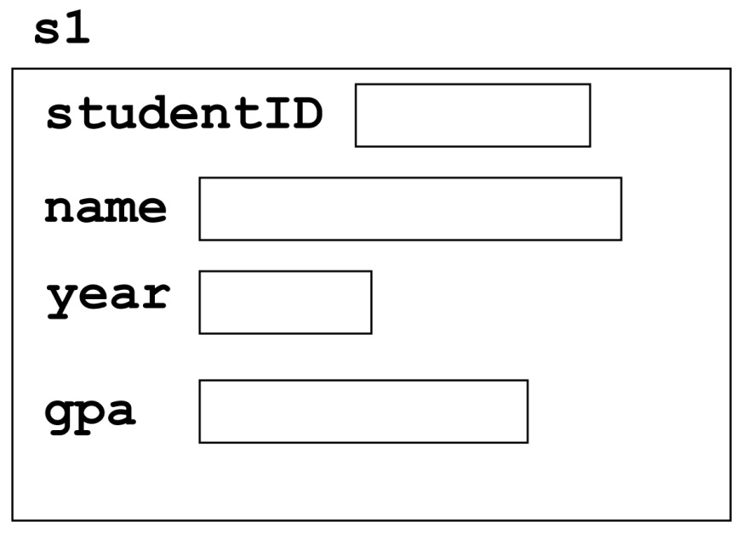
Defining Structure Variables
A struct declaration does not allocate memory or create variables
To define variables, use the structure name as the type name
Student s1;

Slide 159
Accessing Structure Members
Use the dot (.) operator to refer to the data members of struct variables
getline(cin, s1.name);
cin >> s1.studentID;
s1.gpa = 3.75;
The member variables can be used in any manner appropriate for their data type
Notes:
see pr7-13.cpp

Slide 160
Displaying struct Members
To display the contents of a struct variable, you must display each field separately, using the dot operator
Wrong:
cout << s1; // won’t work!
Correct:
cout << s1.studentID << endl;
cout << s1.name << endl;
cout << s1.year << endl;
cout << s1.gpa;

Slide 161
Comparing struct Members
Similar to displaying a struct, you cannot compare two struct variables directly:
if (s1 >= s2) // won’t work!
Instead, compare member variables:
if (s1.gpa >= s2.gpa) // better

Slide 162
Initializing a Structure 1 of 2
Structure members cannot be initialized in the structure declaration, because no memory has been allocated yet
struct Student // Illegal
{ // initialization
int studentID = 1145;
string name = "Alex";
short year = 1;
float gpa = 2.95;
};

Slide 163
Initializing a Structure 2 of 2
Structure members are initialized at the time a structure variable is created
You can initialize a structure variable’s members with either
an initialization list, or
a constructor

Slide 164
Using an Initialization List
An initialization list is an ordered set of values, separated by commas and contained in { }, that provides initial values for a set of data members
{12, 6, 3} // initialization list
// with 3 values

Slide 165
More on Initialization Lists
The order of list elements matters: The first value initializes first data member, second value initializes second data member, etc.
The elements of an initialization list can be constants, variables, or expressions
{12, W, L/W + 1} // initialization list
// with 3 items

Slide 166
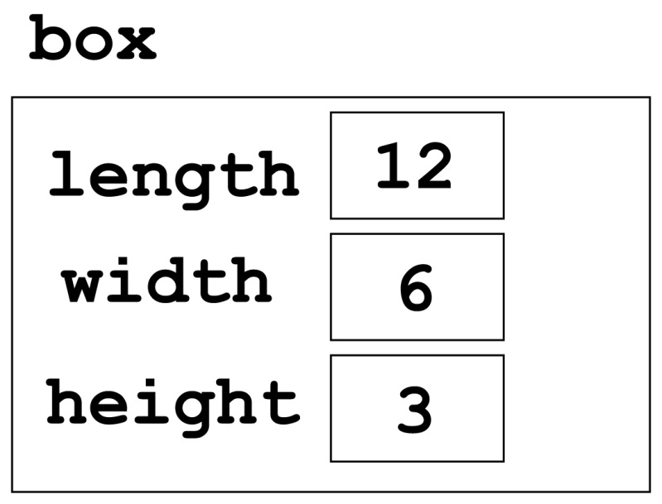
Initialization List Example
Structure Declaration Structure Variable
struct Dimensions
{ int length,
width,
height;
};
Dimensions box = {12,6,3};

Slide 167
Partial Initialization
You can initialize some of the members, but you cannot skip over members
Dimensions box1 = {12,6}; //OK
Dimensions box2 = {12,,3}; //illegal

Slide 168
Problems with Using an Initialization List
You can’t omit a value for a data member without omitting values for all following members
It does not work on most modern compilers if the structure contains objects, e.g., string objects

Slide 169
Using a Constructor to Initialize Structure Members
This is similar to a constructor for a class:
the name is the same as the name of the struct
it has no return type
it is used to initialize data members
It is normally written inside the struct declaration

Slide 170
A Structure with a Constructor
struct Dimensions
{
int length,
width,
height;
// Constructor
Dimensions(int L, int W, int H)
{length = L; width = W; height = H;}
};

Slide 171
Nested Structures
A structure can have another structure as a
member.
struct PersonInfo
{ string name,
address,
city;
};
struct Student
{ int studentID;
PersonInfo pData;
short year;
double gpa;
};

Slide 172
Members of Nested Structures
Use the dot operator multiple times to access fields of nested structures
Student s5;
s5.pData.name = "Joanne";
s5.pData.city = "Tulsa";
Reference the nested structure’s fields by the member variable name, not by the structure name
s5.PersonInfo.name = "Joanne"; //no!
Notes:
See pr7-14.cpp

Slide 173
Structures as Function Arguments
You may pass members of struct variables to functions
computeGPA(s1.gpa);
You may pass entire struct variables to functions
showData(s5);
You can use a reference parameter if the function needs to modify the contents of the structure variable
Notes:
See pr7-15.cpp

Slide 174
Notes on Passing Structures
Using a value parameter for structure can slow down a program and waste space
Using a reference parameter speeds up program execution, but it allows the function to modify data in the structure
To save space and time while protecting structure data that should not be changed, use a const reference parameter
void showData(const Student &s)
// header

Slide 175
Returning a Structure from a Function
A function can return a struct
Student getStuData(); // prototype
s1 = getStuData(); // call
The function must define a local structure variable
for internal use
to use with return statement

Slide 176
Returning a Structure Example
Student getStuData()
{ Student s; // local variable
cin >> s.studentID;
cin.ignore();
getline(cin, s.pData.name);
getline(cin, s.pData.address);
getline(cin, s.pData.city);
cin >> s.year;
cin >> s.gpa;
return s;
}
Notes:
See pr7-15B.cpp

Slide 177
7.13 More About Enumerated Data Types
Additional ways that enumerated data types can be used:
Data type declaration and variable definition in a single statement:
enum Tree {ASH, ELM, OAK} tree1, tree2;
Assign an int value to an enum variable:
enum Tree {ASH, ELM, OAK} tree1;
tree1 = static_cast<Tree>(1); // ELM

Slide 178
More About Enumerated Data Types 1 of 4
Assign the value of an enum variable to an int:
enum Tree {ASH, ELM, OAK} tree1;
tree1 = ELM;
int thisTree = tree1; // assigns 1
int thatTree = OAK; // assigns 2

Slide 179
More About Enumerated Data Types 2 of 4
Assign the result of a computation to an enum variable
enum Tree {ASH, ELM, OAK} tree1, tree2;
tree1 = ELM;
tree2 = static_cast<Tree>(tree1 + 1);
// assigns OAK

Slide 180
More About Enumerated Data Types 3 of 4
Using enumerators in a switch statement
enum Tree {ASH, ELM, OAK} tree1;
switch(tree1)
{
case ASH: cout << "Ash";
break;
case ELM: cout << "Elm";
break;
case OAK: cout << "Oak";
break;
}

Slide 181
More About Enumerated Data Types 4 of 4
Using enumerators for loop control:
enum Tree {ASH, ELM, OAK};
for (Tree tree1 = ASH; tree1 <= OAK;
tree1=static_cast<Tree>(tree1+1))
{
.
.
.
}

Slide 182
Strongly Typed enums (C++ 11) 1 of 4
Enumerated values (names) cannot be re-used in different enumerated data types that are in the same scope.
A strongly typed enum (an enum class) allows you to do this
enum class Tree {ASH, ELM, OAK};
enum class Street {RUSH, OAK, STATE};
Note the keyword class in the declaration

Slide 183
Strongly Typed enums (C++ 11) 2 of 4
Because enumerators can be used in multiple enumerated data types, references must include the name of the strongly typed enum followed by : :
enum class Tree : char {ASH, ELM, OAK};
Tree tree1 = Trees::OAK;

Slide 184
Strongly Typed enums (C++ 11) 3 of 4
Strongly typed enumerators are stored as ints by default.
To choose a different integer data type, indicate the type after the enum name and before the enumerator list:
enum class Tree : char {ASH, ELM, OAK};

Slide 185
Strongly Typed enums (C++ 11) 4 of 4
To retrieve the integer value associated with a strongly-typed enumerator, cast it to an int:
enum class Tree : char {ASH, ELM, OAK};
int val = static_cast<int>(Trees::ASH);
Notes:
See pr7-16.cpp

Slide 186
7.15 Introduction to Object-Oriented Analysis and Design
Object-Oriented Analysis: that phase of program development when the program functionality is determined from the requirements
It includes
identification of classes and objects
definition of each class's attributes
definition of each class's behaviors
definition of the relationship between classes

Slide 187
Identify Classes and Objects
Consider the major data elements and the operations on these elements
Candidates include
user-interface components (menus, text boxes, etc.)
I/O devices
physical objects
historical data (employee records, transaction logs, etc.)
the roles of human participants

Slide 188
Define Class Attributes
Attributes are the data elements of an object of the class
They are necessary for the object to work in its role in the program

Slide 189
Define Class Behaviors
For each class,
Identify what an object of a class should do in the program
The behaviors determine some of the member functions of the class

Slide 190
Relationships Between Classes
Possible relationships
Access ("uses-a")
Ownership/Composition ("has-a")
Inheritance ("is-a")

Slide 191
Finding the Classes
Technique:
Write a description of the problem domain (objects, events, etc. related to the problem)
List the nouns, noun phrases, and pronouns. These are all candidate objects
Refine the list to include only those objects that are applicable to the problem

Slide 192
Determine Class Responsibilities
Class responsibilities:
What is the class responsible to know?
What is the class responsible to do?
Use these to define some of the member functions

Slide 193
Object Reuse
A well-defined class can be used to create objects in multiple programs
By re-using an object definition, program development time is shortened
One goal of object-oriented programming is to support object reuse

Slide 194
Object-Based vs. Object-Oriented
A program that uses classes and objects is object-based.
An object-based program that
defines relationships between classes of objects
creates classes from other classes
determines member function behavior based on the object
is more likely to be an object-oriented program

Slide 195
7.16 Screen Control
Programs to date have all displayed output starting at the upper left corner of the computer screen or output window. Output is displayed left-to-right, line-by-line.
Computer operating systems are designed to allow programs to access any part of the computer screen. Such access is operating system-specific.

Slide 196
Screen Control – Concepts
An output screen can be thought of as a grid of 25 rows and 80 columns. Row 0 is at the top of the screen. Column 0 is at the left edge of the screen.
The intersection of a row and a column is a cell. It can display a single character.
A cell is identified by its row and column number. These are its coordinates.

Slide 197
Screen Control – Windows - Specific
#include <windows.h> to access the operating system from a program
Create a handle to reference the output screen:
HANDLE screen = GetStdHandle(STD_OUTPUT_HANDLE);
Create a COORD structure to hold the coordinates of a cell on the screen:
COORD position;

Slide 198
Screen Control – Windows – More Specifics
Assign coordinates where the output should appear:
position.X = 30; // column
position.Y = 12; // row
Set the screen cursor to this cell:
SetConsoleCursorPosition(screen, position);
Send output to the screen:
cout << "Look at me!" << endl;
be sure to end with endl, not '\n' or nothing
Notes:
See pr7-18.cpp and pr7-19.cpp

Slide 199
Copyright

